Slide 1

Web Security: Broken Access Control & Security Misconfiguration
Atai Toktosunov

Slide 2

Broken Access Control
Broken Access Control is a situation where an application incorrectly restricts access to resources.
The user may receive data or functions that are not intended for him.

Slide 3
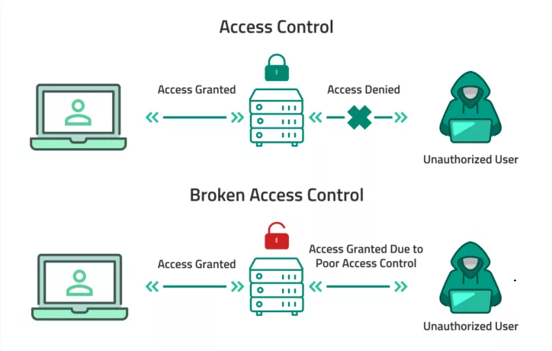
How Hackers Exploit It
Examples of attack:
Change the ID in the URL: /user/101 → user/102
They send requests via DevTools with the admin role
They receive files directly via a direct link
Perform actions that should only be for privileged users.

Slide 4
How to Prevent Broken Access Control
Prevention:
Checking all rights on the server, not in the browser
Clear authorization rules (RBAC, roles, permissions)
Do not trust user data (ID, role, email in the request)
Restricting access to API routes
Regular testing of access scenarios

Slide 5
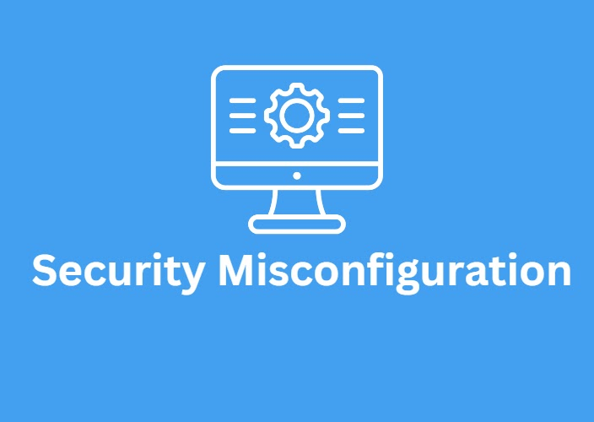
Security Misconfiguration
Definition:
Security Misconfiguration is incorrect server, framework, or database settings.
Examples:
Debug mode enabled in production
Unchanged default logins and passwords
Open admin panels
Public files and folders that should be closed
Error messages that are too detailed

Slide 6
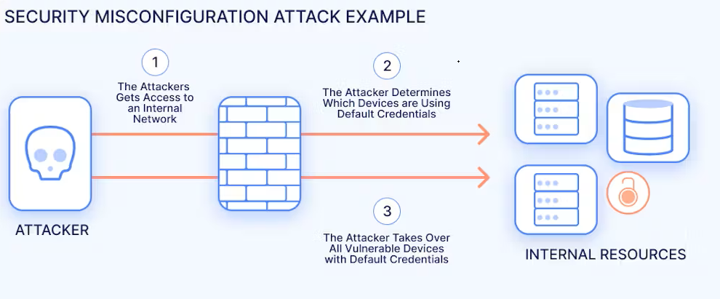
How Hackers Exploit Misconfigurations
Examples:
Through debug panels, they receive a stack trace and secret information.
They find open MongoDB databases without a password
They use automatic scanners to find /admin, /phpinfo, /swagger
Log in to accounts with default passwords: admin/admin

Slide 7
How to Prevent Security Misconfiguration
Prevention:
Disable debug mode
Delete test files, temporary APIs, old endpoints
Change default logins/passwords
Restrict access to the admin area
Regularly update the server, packages, and frameworks
Make automatic security scans (for example, OWASP ZAP)

Slide 8
Summary
Broken Access Control
Security Misconfiguration
Error in access rights
Hackers change URLs, roles, IDs
Solution: strict server checks
Error in settings
Hackers use debug mode, default passwords, open panels
Solution: correct configs, updates, scans

